Slide 1
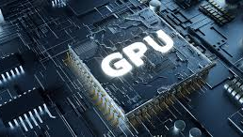

Discovery Training

Slide 2
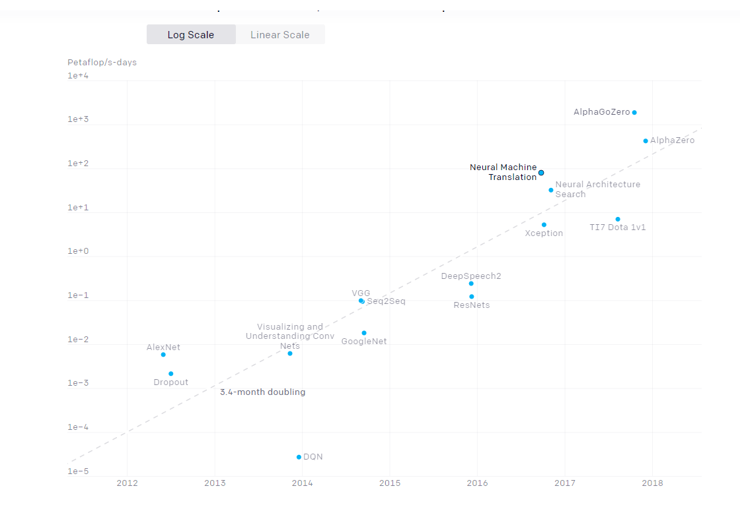
AlexNet to AlphaGo Zero: A 300,000x Increase in Compute

Slide 3
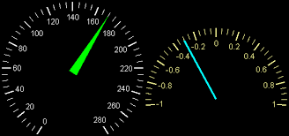
Petaflop
one thousand teraflops
a unit of computing speed equal to one thousand million million (10¹⁵) floating-point operations per second
Teraflops
a unit of computing speed equal to one million million (10¹²) floating-point operations per second

Slide 4

Distinct eras:
Before 2012
uncommon to use GPUs
2012 to 2014
many GPUs was uncommon
only 1-8 GPUs rated at 1-2 TFLOPS
2014 to 2016:
10-100 GPUs - 5-10 TFLOPS
2016 to 2017:
parallelism -batch sizes
TPU’s
AlphaGo
2020
Fugaku - 415 quadrillion computations a second

Slide 5

Three factors drive the advance of AI
Algorithmic Innovation
Data
Amount of compute power

Slide 6
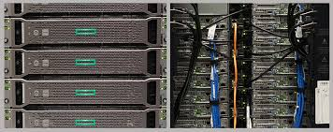
Discovery
High Performance Computing (HPC) resource
Located - Massachusetts Green High-Performance Computing Center
90,000 square-foot, 15-megawatt research computing and data center
Northeastern, BU, Harvard, MIT, and UMass

Slide 7
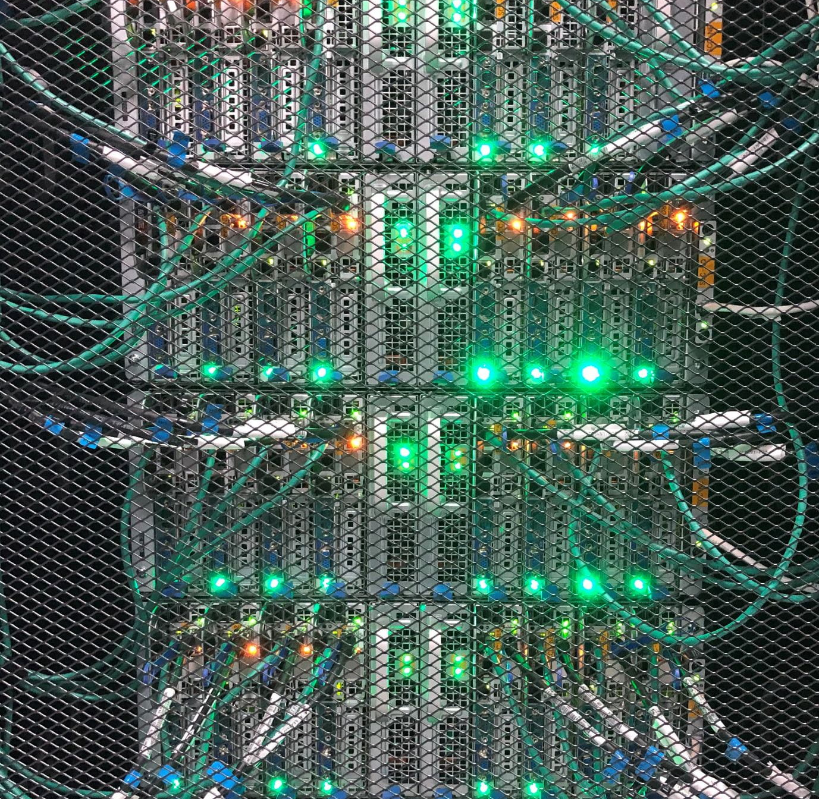
Research Computing at Northeastern University

Slide 8
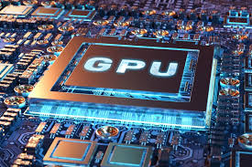
Hardware
Over 20,000 CPU Cores and Over 200 GPUs
The Discovery cluster consists of a combination of the following CPUs and GPUs:
2.4 GHz Intel E5-2680 v4 CPUs
2.1 GHz Intel Xeon Platinum 8176 CPUs
A selection of NVIDIA K80, P100, V100, and T4 GPUs

Slide 9
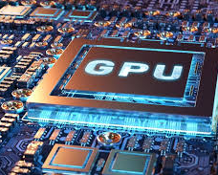
Discovery Resources
Shared resources
Reserved Node

Slide 10
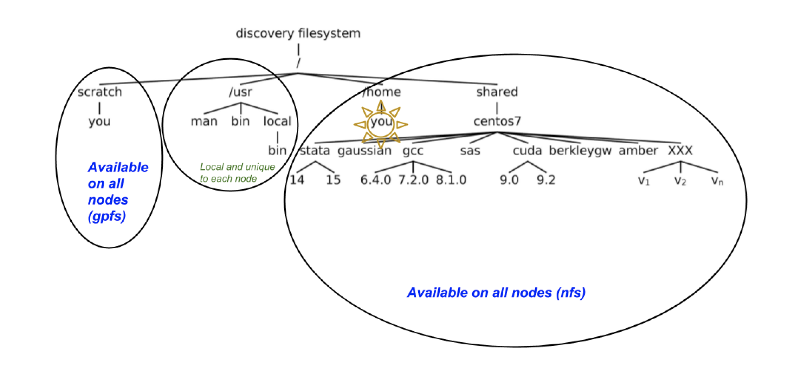
Discovery filesystem

Slide 11

Data Transfer
Mac or Command line
On Command line(Linux like terminal)
scp
Run the commands on your local machine
scp <filename> <yourusername>@xfer.discovery.neu.edu:/home/<yourusername>/temp
Where <filename> is the name of the file you want transfer and <your username> is your Northeastern username.

Slide 12

Scratch Space
The /scratch space is a shared space
Do not store files on /scratch.
Not backed up
Files are regularly checked for how long they have been.
Avoiding your files being purged by modifying file times

Slide 13
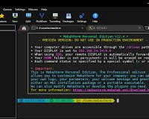
Data transfer Graphically
MobaXTerm
Winscp
OOD

Slide 14
Using Module
Module Command | Function
module avail | View a list of all of the available software packages on Discovery that you can load
module list | Displays a list of the software packages currently loaded in your path
module show <module name> | View the details of a software package
module load <module name> | Load a software package into your environment
module unload <module name> | Remove a single software package from your environment
module purge | Removes all of the loaded software packages from your environment.

Slide 15

Miniconda
Linux installers
Python 3.8
Miniconda3 Linux 64-bit
88.7 MiB
Download it
Copy it to the discovery

Slide 16

Miniconda
bash miniconda
Conda init
Restart
Conda create –n myenv python=3.7
Conda activate myenv

Slide 17
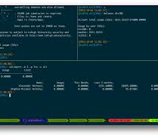
SLURM
Simple Linux Utility Resource Management https://slurm.schedmd.com/documentation.html
For basic cluster information:
sinfo , sinfo –p partition-name
For information on partition and nodes configuration:
scontrol show partition=partition-name,
scontrol show nodes=node-name

Slide 18
Running jobs
Do not run jobs on the login nodes.
Do not use Discovery for any purpose other than for Northeastern University sponsored research.
Review and comply with Northeastern’s Policy on Appropriate Use of Computer and Network Resources

Slide 19
Command
srun --pty /bin/bash
srun --p partition-name --pty /bin/bash
srun --reservation=reservation-name --pty /bin/bash
srun -p gpu --pty --gres=gpu:1 --mem=10Gb --time=01:00:00 /bin/bash,
srun -p reservation --reservation=CSYE7374_GPU --gres=gpu:v100-sxm2:4 --pty --mem=95000 --time=10:00:00 /bin/bash

Slide 20

Basic Regression
Boston Housing Data

Slide 21

Batch Script
bash script
resources
number of nodes
memory
Slurm then schedules it
sbatch example.script

Slide 22
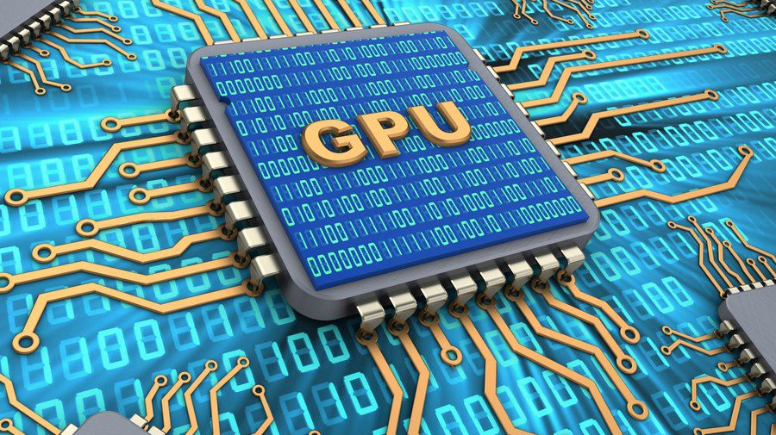
Using GPUs On Discovery

Slide 23

Introduction to GPUs
CPUs vs GPUs
Various GPUs on Discovery and how to access them
Parallel computation using GPUs
Various examples of simple GPU application

Slide 24

CPUs vs GPUs
GPUs used as co-processors
Massively parallel architecture - GPU
CPU cores smarter - process large & broad instruction sets, manage I/O of a computer.
GPU cannot do that

Slide 25

GPU Programming Languages & Directives
CUDA
Halide
OpenACC
OpenCL

Slide 26
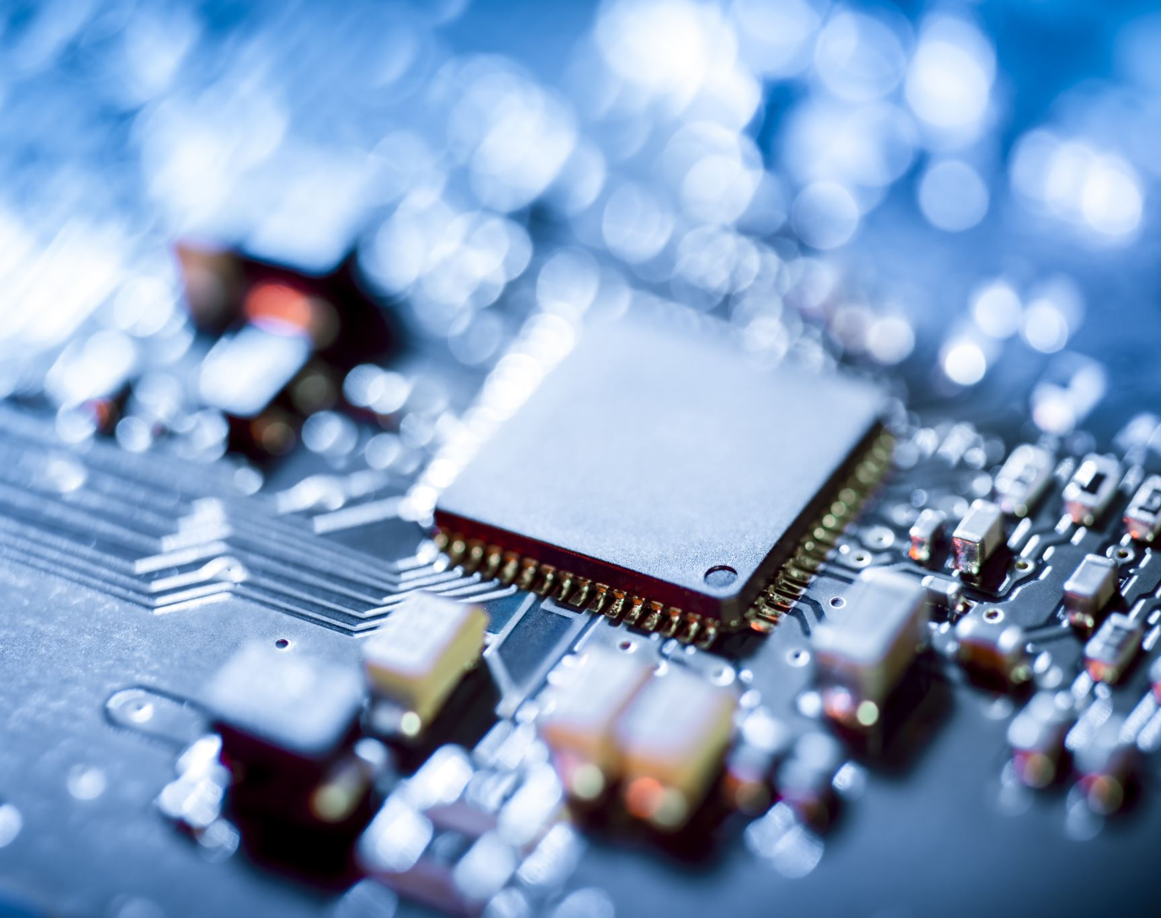
Tensorflow For GPU

Slide 27
Conda environment
Create the environment using conda create
conda create --name TF_env python=3.7
Activate the environment using
conda activate TF_env
Install gpu version of tensorflow
conda install -c anaconda tensorflow-gpu

Slide 28
Running it
srun --partition=gpu --nodes=1 --pty --export=All --gres=gpu:1 --mem=1G --time=00:30:00 /bin/bash
module load cuda/10.2
python tf_code.py

Slide 29
Open OnDemand (OOD)
Available Apps (June 2020)
Jupyter Notebook (includes Python 3 and R 3.6.1 kernels)
RStudio
MATLAB
conda install -c anaconda ipykernel
Python3 –m ipykernel install --user --name=Tf

Slide 30

Important Links
https://rc-docs.northeastern.edu/en/latest/index.html
https://slurm.schedmd.com/documentation.html
https://mobaxterm.mobatek.net/download.html
https://www.putty.org/
https://winscp.net/eng/download.php
https://docs.conda.io/en/latest/miniconda.html

Slide 31


